Slide 1
Dialogue systems V23 Project: Dialogue-based Game
Victoria Filippatou

Slide 2
agenda.
THE GAME 3
IMPLEMENTATION 4
CHALLENGES 5
UTILIZATION OF COURSE MATERIALS 6
FUTURE DEVELOPMENTS 7

Slide 3
the game.
Language learning game → practice a foreign language in a more natural environment, based on role play. Practicing vocabulary used in context instead of individuals words.
Super-market setting:
system → shopping assistant
user → customer
Points for correct and wrong answers. Game over → timer = 0.
Different pictures of items appear on the screen → the user has to successfully ask the shopping assistant for them.
Beginner’s level game → simple explanations and instructions.

Slide 4
implementation.
The game was developed using TypeScript and the xstate library. It runs on a web-based platform accessible from any web browser → Speechstate
The already existed code was used as base for its development. Any alterations made in that, regarded the state machine and its transitions as well as the html and css files, in order to make the game able to display pictures.
The Azure Cognitive Services were recruited for intent recognition and entity extraction combined with a grammar interface for intents that did not have to be generally captured, i.e., the user is advised by the system to say help if they don’t know how to proceed to the next state.
The transitions and the different game states were managed in a state machine with the help of statecharts.
The different photos that are used at each state were sourced from PNGWing.

Slide 5
challenges.
Building the game, when it’s the first time one takes over such a task. This was solved by researching similar games, gathering inspiration, and trying to think what would make someone want to use this game to practice a foreign language.
Creating efficient code that is not repetitive. Some functions were created with that in mind, with the hope of making the code simpler and more concise.
Implementing a timer was a big challenge.

Slide 6
utilization of course material.
The tutorials and coding sessions helped in structuring the code in a clear way and getting familiarized with the new tools in order to build the game.
Statecharts were a suitable implementation for this project, since it was clear and easy to keep track of the transitions and different stages of the game.
Peer feedback was useful in implementing features such as bonus stages or in capturing as many ways as possible someone can ask for the same thing.
Ethical concerns → future role-play contexts. Woman shopping assistant.

Slide 7
future developments.
The game can be translated in more languages and be used by more people. Started implementing it for Swedish, can be implemented for Greek too.
It can be expanded to hold more real-life settings the user can choose from, rather than just a supermarket one, like chit-chatting/small talk, ordering food at a restaurant, travelling etc.
The player can stop the game whenever they want.

Slide 8
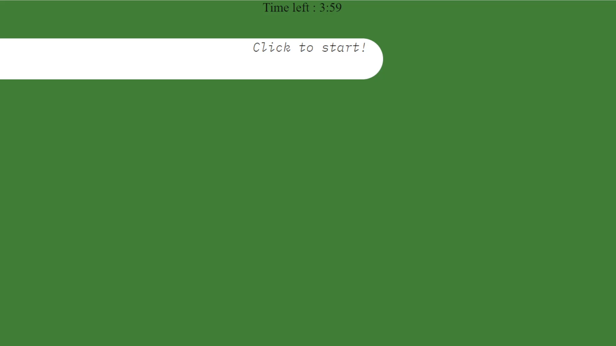
game demo.

Slide 9
thank you
Victoria Filippatou

